Slide 1
Ion Beam Tutorial Presented to: AFIT NENG 612 Aug 20, 2019
What has been is what will be, and what has been done is what will be done, there is nothing new under the sun - Ecclesiastes 1:9
Paul Adamson
for David Hinshelwood dave.hinshelwood@nrl.navy.mil
Plasma Physics Division, Naval Research Laboratory

Slide 2
This talk summarizes our use of MV-level ion (proton) beams as surrogates for soft x-rays in materials testing
Why ion beams are attractive
Basics of ion-beam diodes
Review of our extensive ion-beam testing program in the last century
Review of our current program
Beam characterization
Limitations
Risk-mitigation research efforts and directions
Thoughts on where ion-beam testing fits in among other technologies

Slide 3
Why are ion beams useful soft-x-ray surrogates?

Slide 4
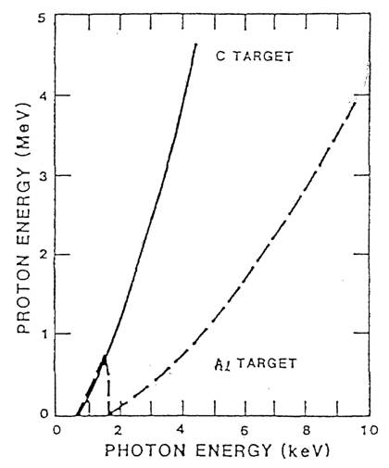
1- to 5-MeV intense ion beams provide a validated simulation of cold x-ray effects requiring large fluence-area products
Ion penetration depths are similar to those of cold photons
Equivalent hν depends on atomic number
Fidelity issues for layered-Z materials
Large fluence x area products available
30-kJ proton beam on Gamble II, 30-50 ns FWHM power pulse
0.1 to 100 cal/cm², FA > 1000 cal
uniformity ±20% over A
High-fidelity cold x-ray simulation
"Plane-wave" exposure of 3D objects
Spectrum tailoring by mosaic filtering and impedance control
Debris mitigation due to target stand-off
Debris-window: optically-clean up to 0.5 cal/cm²
Clean solar cells without window at 0.8 cal/cm²
Time separation of beam- and debris-induced impulses at 10's of cal/cm²
Ion vs Photon Energy for
Equivalent Penetration Depth

Slide 5
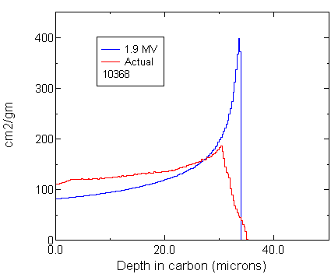
Time-varying voltage averages Bragg peaks into an almost rectangular profile
Calculations from SRIM
AWE/Harris/NRL/SNL have compared deposition calculations from a variety of codes and seen good agreement for Al, C, SiO2, and Au
This provides a good comparison with front-surface sources (DLI, LIHE, Flyers)
To obtain x-ray-like profile, need to enhance low-energy portion of beam spectrum
Selective filtering (mosaic)
Tailoring of voltage waveform
Ion and photon absorption have differing Z-dependence
Fidelity may be difficult or impossible to obtain for some layered materials
Deposition profile
for typical spectrum

Slide 6
Mosaic filtering is a powerful technique to produce PRS- or threat-like deposition with ions.
Emitted by Diode
On Target
20% to 50%
loss in fluence*area
depending on desired
deposition and
ion energy

Slide 7
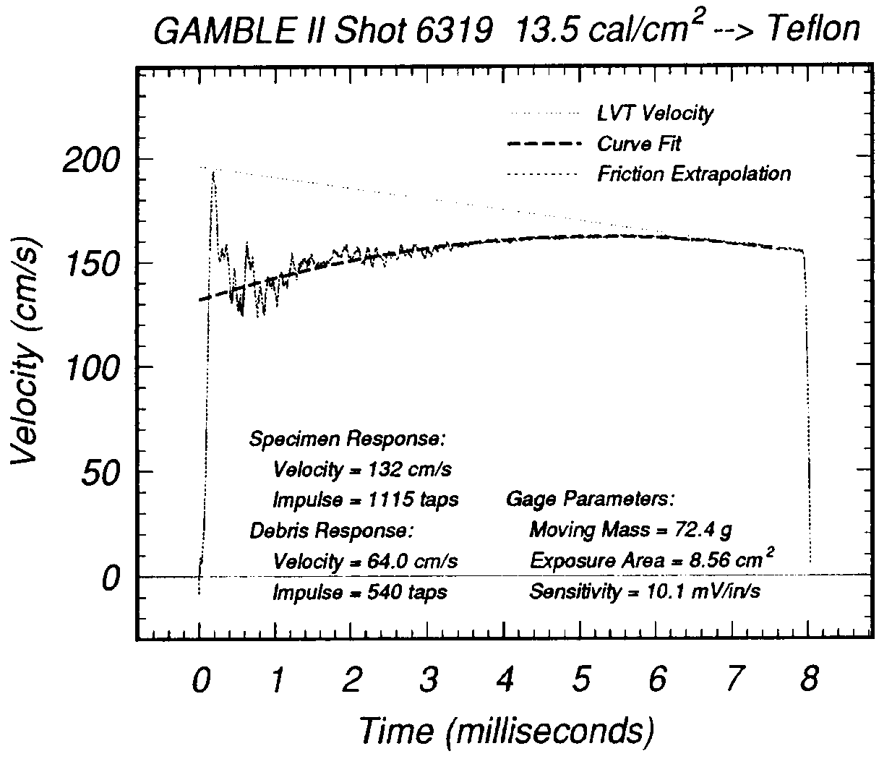
Large stand-off distance permits separation of test and debris impulses with ion beams
LVT Impulse Gauge Response
High fluence precludes debris shield and requires low target stand-off in PRS experiments - debris impulse difficult to separate from x-ray-induced impulse
Separation of effects with ion beams can reduce uncertainty
Ref: G. Williams, Ion Beam Validation Program Impulse Experiment Preliminary Results, 1995.

Slide 8
Ion beam diodes

Slide 9
Stages of operation in a pinched-beam diode
Electric field causes plasma formation on cathode
Space-charge-limited electron flow
I ~ V^{3/2}
Critical current
I ≈ V * R / D
Anode plasma formation
Strong pinching
and ion current
D
R
C
L
+
_
+
_
+
_
+
_
+
_

Slide 10
Ion-current fraction is determined by space-charge balance
Bipolar flow
Ii / Ie ~ (m_{e} / m_{i)}^{1/2}
Pinched flow
Ii / Ie ~ (m_{e} / m_{i)}^{1/2}
* R / D
Reflexing
Ii / Ie ~ (m_{e} / m_{i)}^{1/2}
* R / D * 2
Assume balance of ions and electrons in gap (otherwise, charge would be pulled in)
Current ~ 1 / (time of particle in gap)
⇒ Current ~ velocity / distance across
Relativistic limit to electron velocity reduces electron fraction below estimates at right
Full analytic treatment and numerical modeling confirm these simple arguments to within roughly a factor of two
The ion fraction can exceed 50% under the conditions of our experiments
C
L
+
_
+
_
_
_
+
+

Slide 11
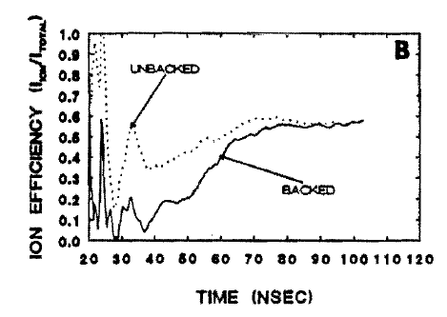
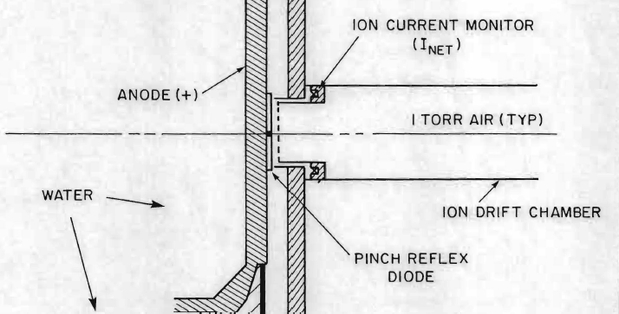
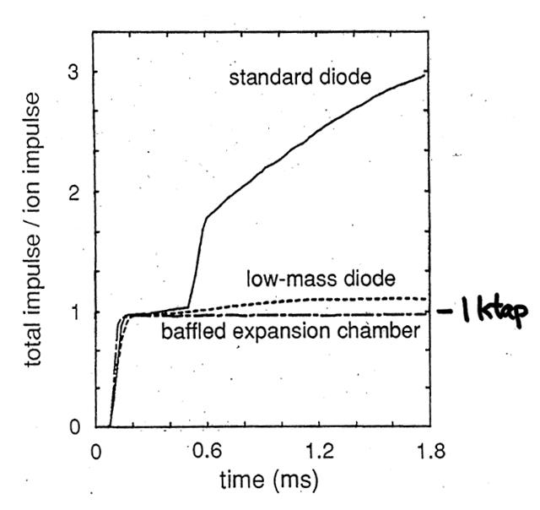
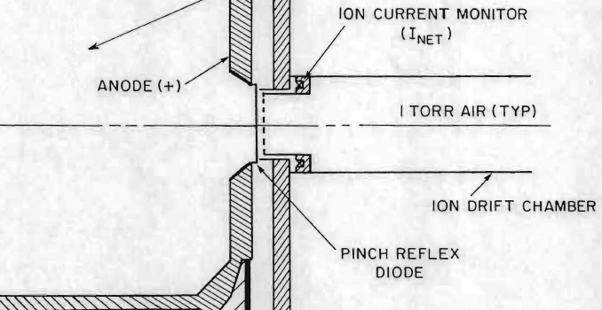
The “backless” diode (Stephanakis, c. 1990) gave a dramatic reduction in debris with a slight increase in ion efficiency
Standard PRD
Ion / total current
Impulse
Backless PRD
Diode operation seems to be the same in spite of different electron flow!
11

Slide 12
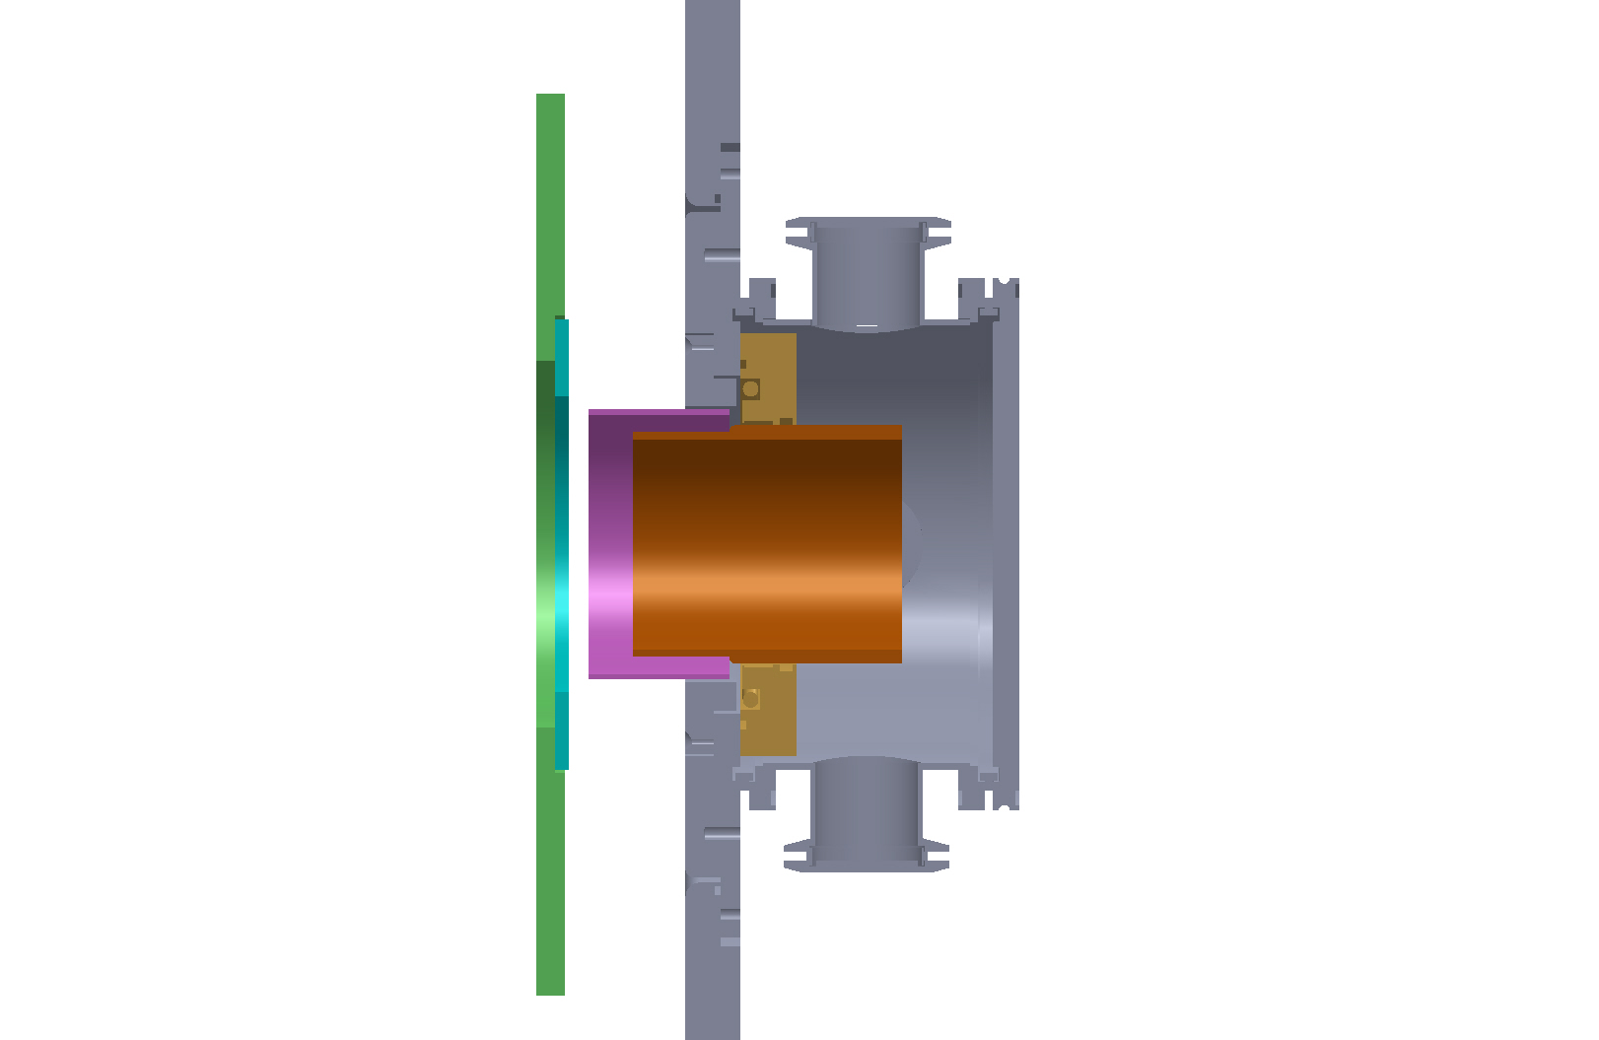
A thin foil separates diode vacuum from transport chamber, and facilitates ion-current measurement
Cathode
Ion Rogowski
Kimfol
Snout
Anode foil

Slide 13
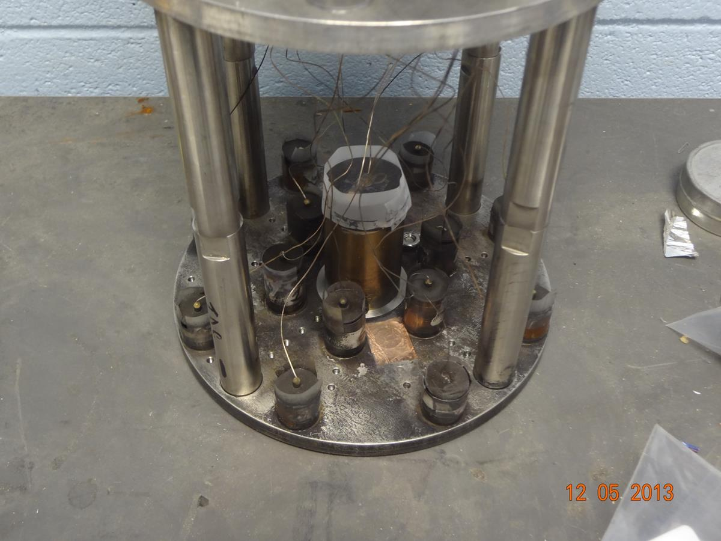
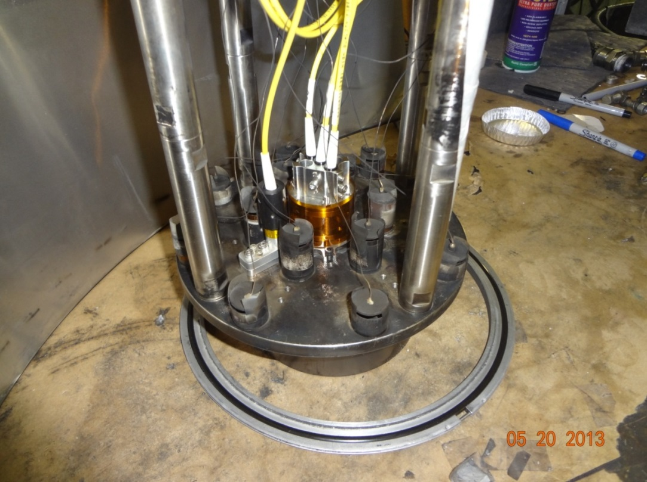
General arrangement for ion-beam testing then and now
Fluence on target inferred from peripheral calorimeters, based on mapping shots
ion current
Mapping shot
entrance foil
(1.8-µ “Kimfol”)
setback = (1-2)D
anode foil
R
C
L
z
test object
Data shot
e-beam dump
D
I ∝ R / D
D = D₀ - vt
cathode
gas-filled (optional) transport-focusing cell
Beam transport in vacuum appears to be the same as in 1-Torr air!

Slide 14
A wide array of beam diagnostics are applied to ion-beam NWES experiments
(not used in recent work)
Low current density (fluence)
Calorimetry
Nuclear activation
Radiochromic film, depth-dose stack
Fast (on beam timescale) bolometry
Thomson parabola
Magnetic spectrometer
Apertures with expanding beamlets allow use in high-fluence experiments
High current density (fluence)
Rutherford scattering
(Time-integrated) imaging of characteristic gammas from protons on fluorine
(Time-resolved) framing photography of scintillator
Neutron time-of-flight
Measurement of K-α radiation
Interferometry (gas ionization or co-moving electrons)

Slide 15
Work in the last century

Slide 16
Ion-beam chronology as of 1997

Slide 17
User-driven Gamble II ion-simulation tests led to the DTRA ion-validation initiative

Slide 18
Excellent ion-AGT/UGT correlations have been obtained with Mineral Quarry material response
AF/BMO Reduced
Impulse Materials
AF/BMO Reentry
System Enhancements
Pre-UGT Ion-Test Results
Porous Teflon samples did not reduce impulse compared to solid Teflon
Laminate Teflon samples enhanced impulse
Ref: Ktech/TR-91/06
UGT Results
Porous Teflon samples did not reduce impulse
Laminate Teflon samples enhanced impulse
Ref: POR 7404
Pre-UGT Ion-Test Results
Nosetip fluence catastrophic failure levels determined
At fluences below failure, fuzzy surfaces developed
Ref: Ktech/TR-91/06
UGT Results
No catastrophic damage in agreement with Gamble II measured failure levels
Fuzzy surfaces developed
Ref: POR 7404

Slide 19
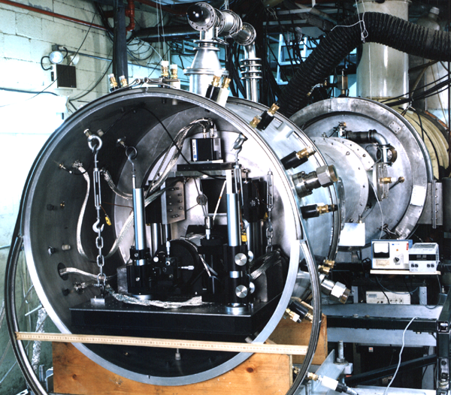
Gamble II ion beams have been used for
TSR testing of an operating telescope
Thermostructural response testing of a working telescope system consisting of
4” aluminum Cassegrain telescope
0.5x0.5-mm² focal-plane camera
9000-frame electronics and memory
illuminating laser and 5” expansion optics,
multi-level vibration isolation
The Gamble II ion mode provided an excellent testing environment
200-cm² exposure area with less than 10% nonuniformity
Integral debris window
"Plane-wave" exposure of a 3D object
Results provided new structural-response data that could not be obtained in another AGT or by thermostructural response codes
Deviations from codes observed at long time scales
New decay and joint-damping parameter vs frequency data to correct systems codes

Slide 20
The DTRA Validation Study showed that Gamble II provided a user-friendly and versatile ion-testing environment
Gamble II Test Matrix for the Ion Validation Study
Next-shot response to experiment changes
Early or on-time completion of all tests
Shots delivered exceeded the number scheduled
93% in-spec shot rate
Excellent data recovery
± 10% shot-to-shot reproducibility and fluence uniformity
Multiple-sample testing permitted by large fluence-area
planned
days
shots
delivered
days
shots

Slide 21
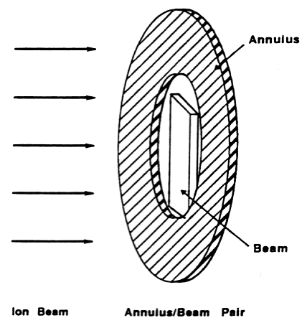
Results from all four test series confirmed the utility of ion-beam NWES
Mirror materials (JAYCOR)
Be and SiC disks exposed to ion beam and diagnosed using strain gauges
“The untailored 1.9 MeV Gamble II ion beam can produce deformations/strains in Be and SiC disks comparable to those obtained in the MQ UGT and from validated analytical models”
“Tailoring or higher end-point energies may be required to provide increased bending moments”
Nonlinear TSR (APTEK)
Useful data obtained at a range of fluences spanning linear to nonlinear response
Threshold fluence for nonlinear response in Al 7075 T73 determined
Results correlate well with UGT data
“The nonlinear TSR test series performed at Gamble II was a success…ion beams can be used to simulate x-ray induced nonlinear TSR”

Slide 22
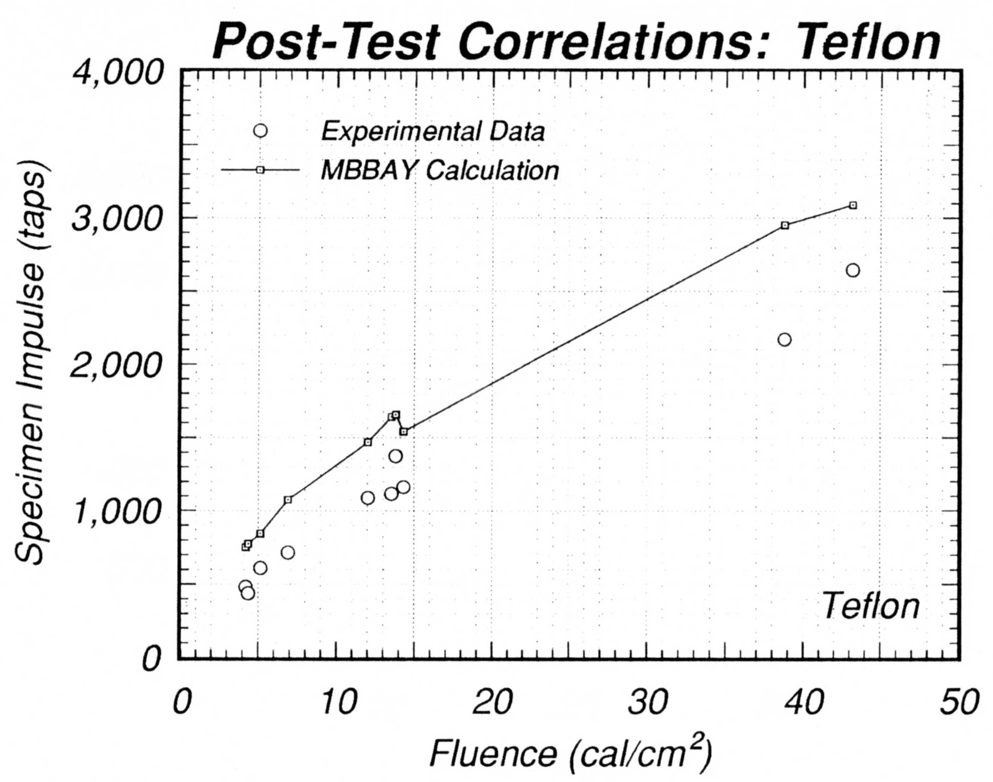
Ion-beam impulse data were obtained. These data agreed with APTEK calculations
Ion fluences on test materials were 5 to 45 cal/cm² over 80 cm²
Tested materials were AS3DX, TWCP, graphite, and Teflon
Calculated impulse based on the ion fluence measurements and spectrum were about 25% higher than the measured impulse
Likely due to vaporization of steel front plate holes, increasing energy measured in the calorimeter
“Ion beam good for generating vapor-dominated impulse”
“Excellent S/N ratio achieved for impulse measurements”
Ref: G. Williams, Ion Beam Validation Program Impulse Experiment Preliminary Results, 1995.

Slide 23
Multi-layered optics were exposed to crudely- tailored ion beams during JAYCOR multi-layer optics tests
Deposition in SiO₂
for a Fluence of 1 cal/cm²
mosaic spectrum
S_{m}(E) =
+ (1-y)²S(E,0)
+ 2y(1-y)S(E,T)
+ y²S(E,2T)
unfiltered
filtered by T
filtered by 2T
Al thickness
T(μm)
y
1-y
Simple 3-element mosaic at 45º was matched to the Gamble II ion spectrum: T = 7 μm, y = 0.5
Deposition matched the surface dose and fall-off of Double Eagle argon PRS used to expose identical samples
Damage modes in optics were the same as observed in UGTs and PRS tests

Slide 24
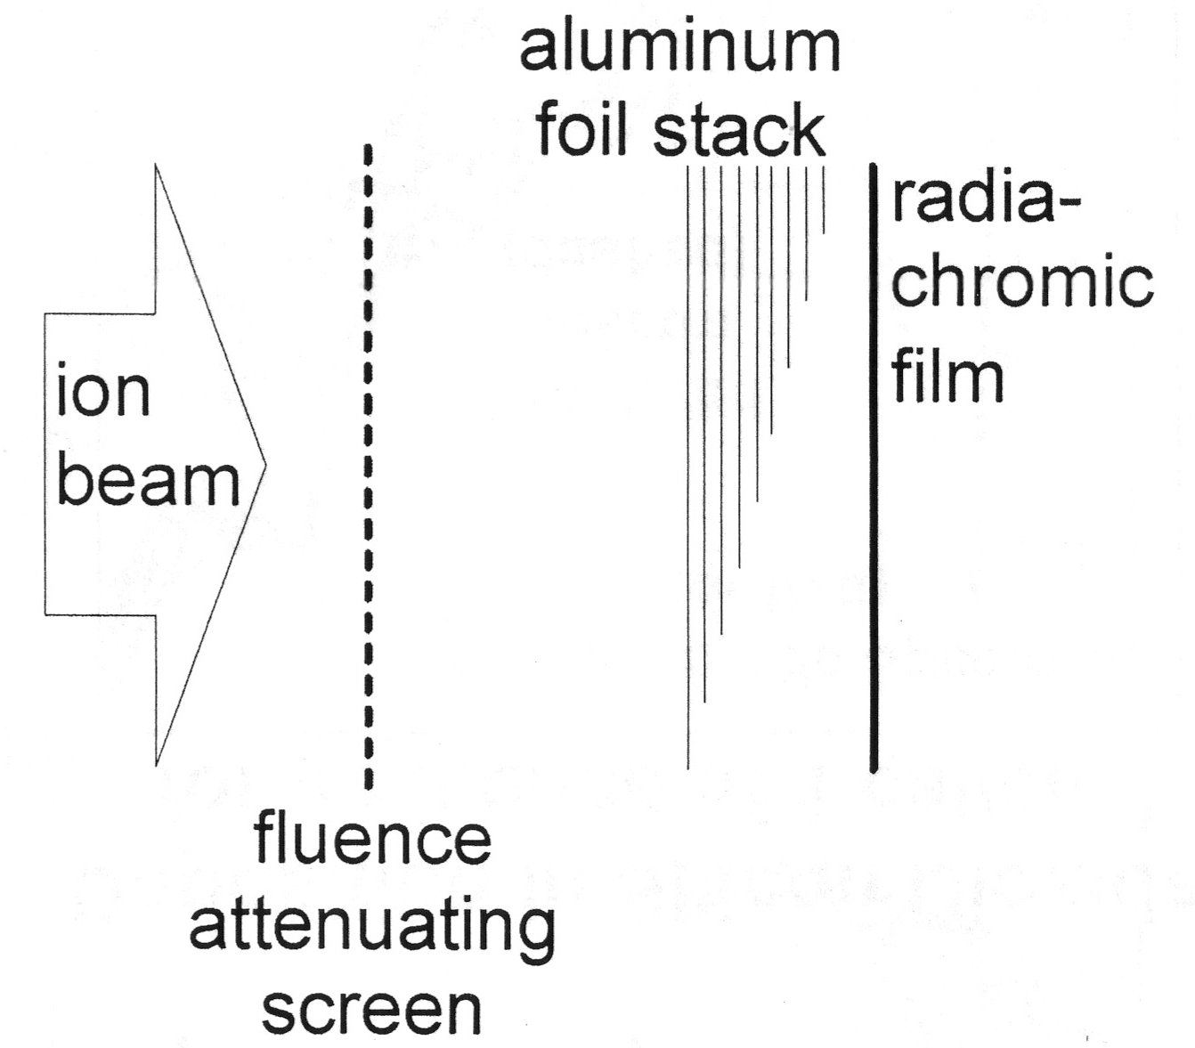
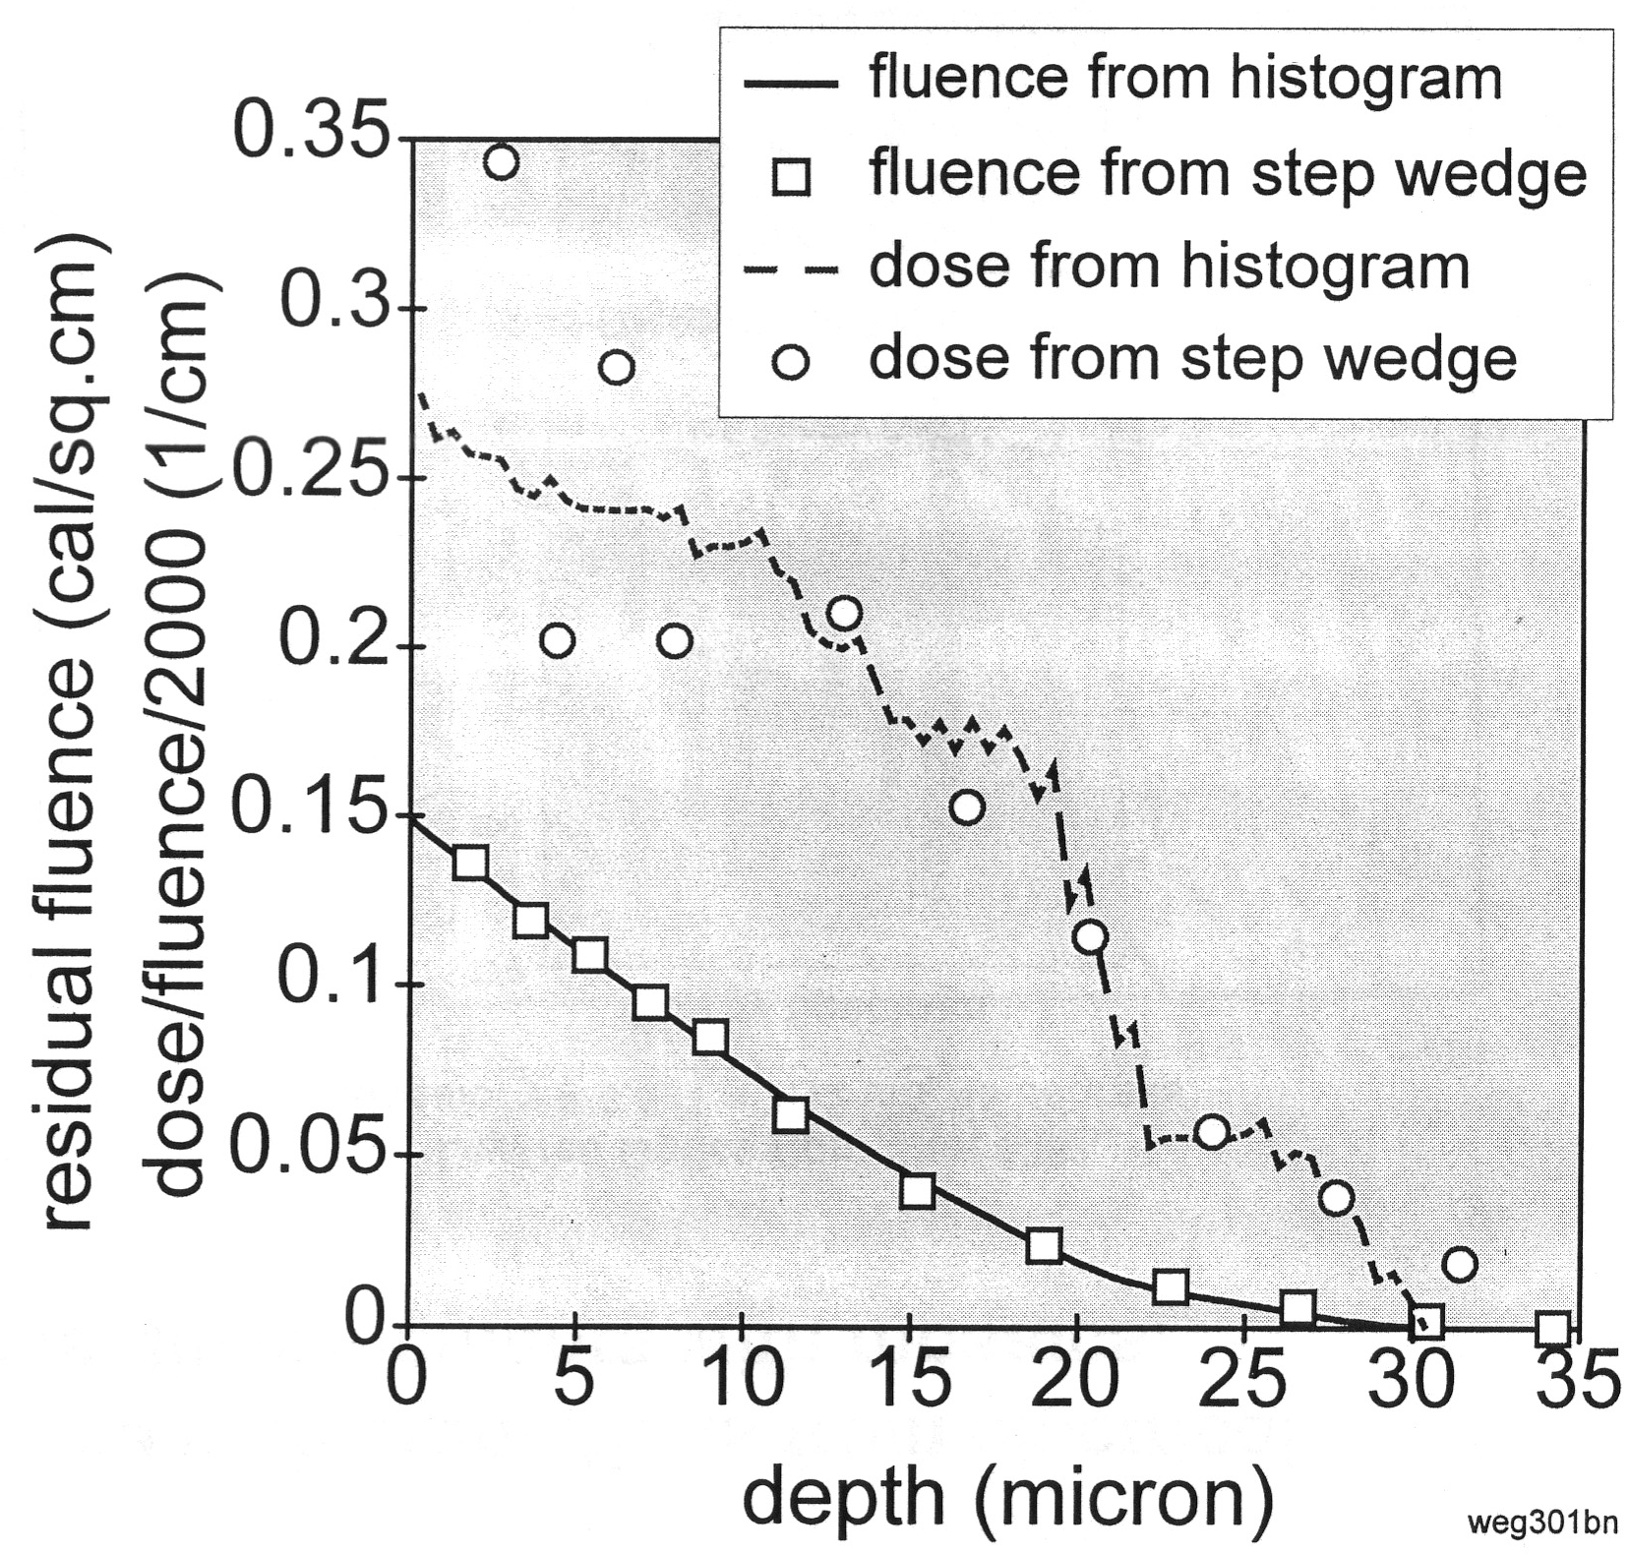
Ion-beam step-wedge data confirms dose profiles derived from electrical data
Comparison of Ion Deposition in Al from a Foil-Stack and Electrical Data
1.8- and 4-mm-thick foils resolved ion deposition
Radiachromic film calibrated with calorimeters
Film exposure density proportional to deposited fluences up to 0.25 cal/cm²

Slide 25
The DTRA Validation Study verified that ions can replace cold x-rays for many effects tests
Correlated ion-beam-induced effects with UGTs, PRS AGTs, and validated codes for
linear and nonlinear thermostructural response of mirror materials, mirror structures, composite tubes and strips
optical multi-layer coatings with tailored, x-ray-like deposition
blow-off impulse in complex composite materials
JAYCOR, APTEK, and S-Cubed tests proved that ion beams are useful for testing optical components and strategic materials
Damage modes the same as for UGTs and PRS tests
Impulse response similar to that of a 1-keV black body
Not all issues resolved for multi-layers, baffles, and buckling
Lessons learned include specifications for a high-fidelity ion simulator to meet long-term testing objectives
5- to 8-MeV endpoint for penetration and nondestructive testing
spectrally-tailored with x-ray-like deposition for complex structures
advanced debris mitigation techniques for optics testing

Slide 26
Ion exposures validated an advanced solar cell technology within mission specs established by JCS guidelines
L-3 Double Eagle Ar PRS at ≤ 0.3 cal/cm² over 53 cm² could not induce cracking in flight-configuration cells
Ions provided more penetrating, debris-free, uniform fluences up to 0.8 cal/cm² over 1000 cm² (8 cells) without debris windows
2 cell coupon
calorimeter
radiachromic
film
Survivability determined on Gamble II by establishing a 0.4-cal/cm² cracking threshold
Methodology established for future testing of new solar-cell materials in which Gamble II ion testing is an integral part
Navy UFO Communications Satellite Payload

Slide 27
Recent work

Slide 28
In response to AWE desirement, we varied the diode geometry to alter the impedance history and thus the deposition profile
standard
foil flush
half-scale
0.5 R, 0.7 D,
foil flush
0.5 R, 0.7 D,
foil back

Slide 29
Impedance tuning can produce desirable deposition profile
Calculated Ion Deposition in Carbon
Normally-incident ion beam uniform over 10 cm²
This result helped start our AWE program, but could not be obtained reliably in testing scenarios!
Mosaics were used on some shots in 2012

Slide 30
We have had a small but steady effort over the last 8 years
Working with AWE and Excelis Harris Peraton
Roughly 5 weeks / 100 shots per year (no testing last year because of AWE security issues)
The ion beam has been well characterized
Calorimetry for fluence
Carbon activation for profile
Rutherford scattering for endpoint and pulse shape
Depth-dose stack for spectrum
Electrical monitors
A variety of materials have been studied using several target diagnostics
Both traditional and novel materials
Photonic-displacement interferometry
LVT, pressure, and strain gauges
For the first time, we now have support for source improvement (a small amount last year also)

Slide 31
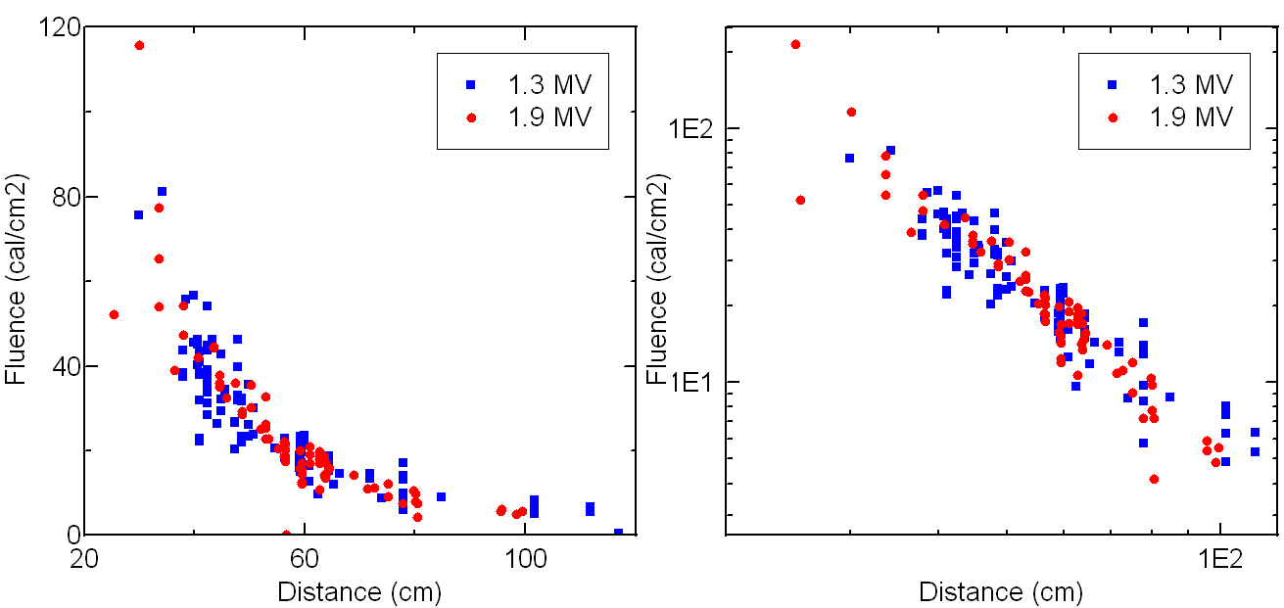
Fluences up to 115 cal/cm² are measured
Linear scale
200 cal/cm2?
Log scale
Fluence easily variable from 5->115 cal/cm²
Significant shot-to-shot variation

Slide 32
Validated ion-current model allows ion current determination in absence of direct measurement
Model matches on shot without monitor failure
Model needed after monitor fails

Slide 33
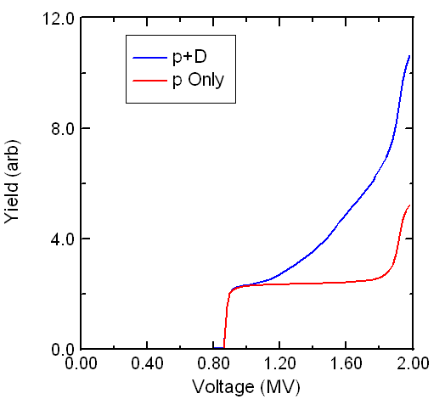
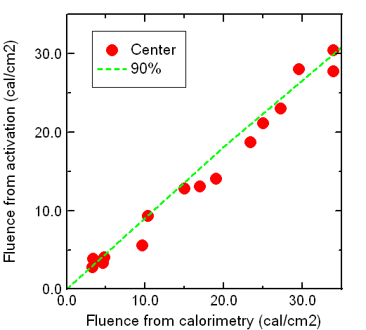
The ¹²C(p, γ)¹³N reaction is a useful proton diagnostic, but requires voltage-dependent deuteron correction
Yield for protons and p:d mix assuming natural ratio / 1.4
Activation vs calorimeter fluence
for central calorimeter
Average deuteron correction of 1.5x

Slide 34
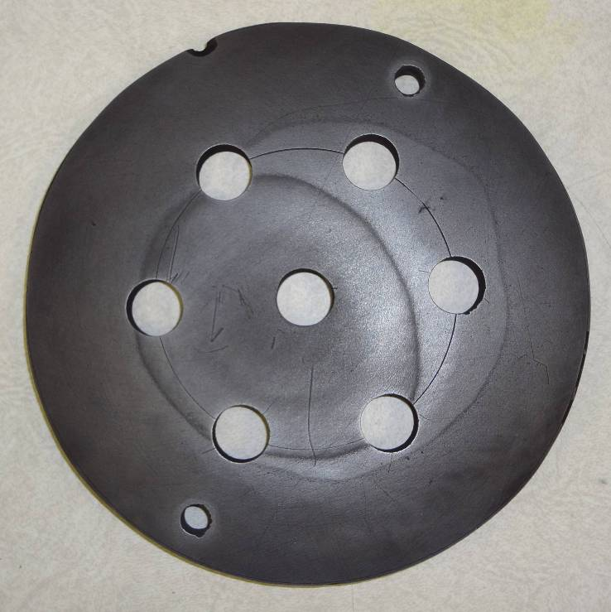
Graphite ablation seen at ~12 cal/cm²
Carbon activation images beam
Ablation of activated carbon reduces
image-plate dose
Calorimeters behind holes in plate
11.3 cal/cm²
13 cal/cm²
8.7 cal/cm²

Slide 35
Rutherford-scattering time-of-flight measurement verifies end-point voltage
Signal from p-i-n located 375 cm from the diode
compared with absolute calculations
Ion TOF
X-rays

Slide 36
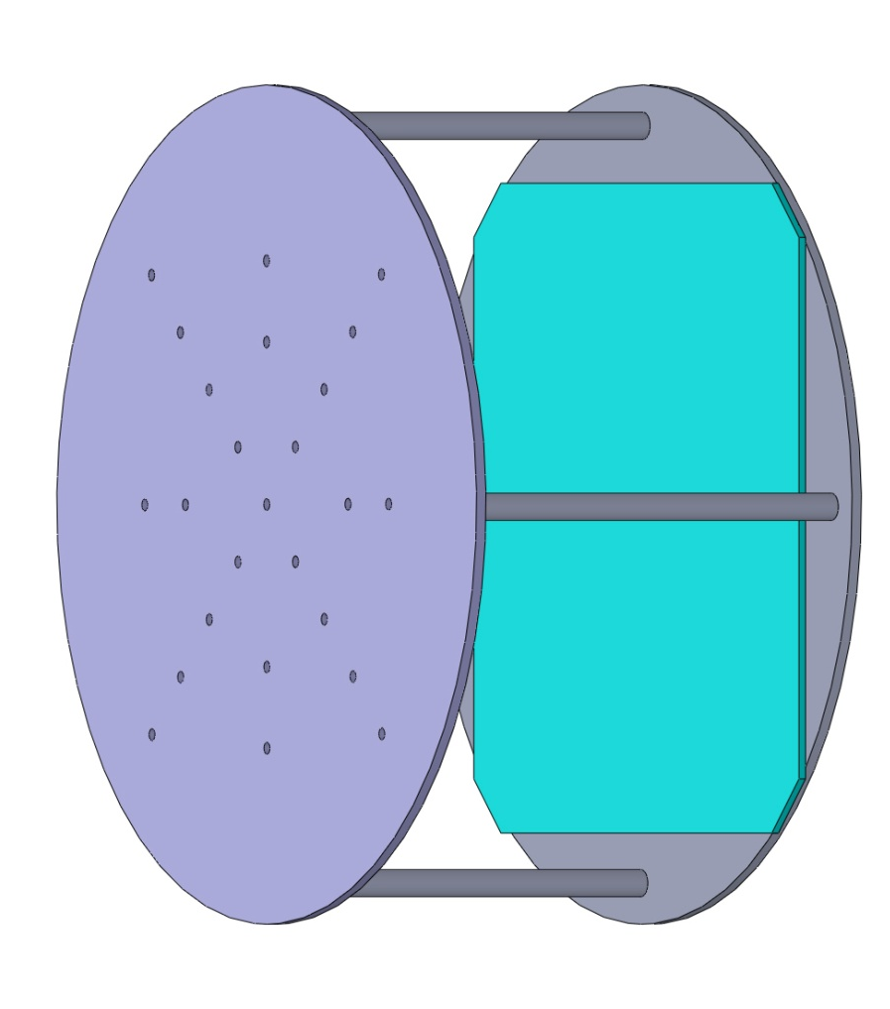
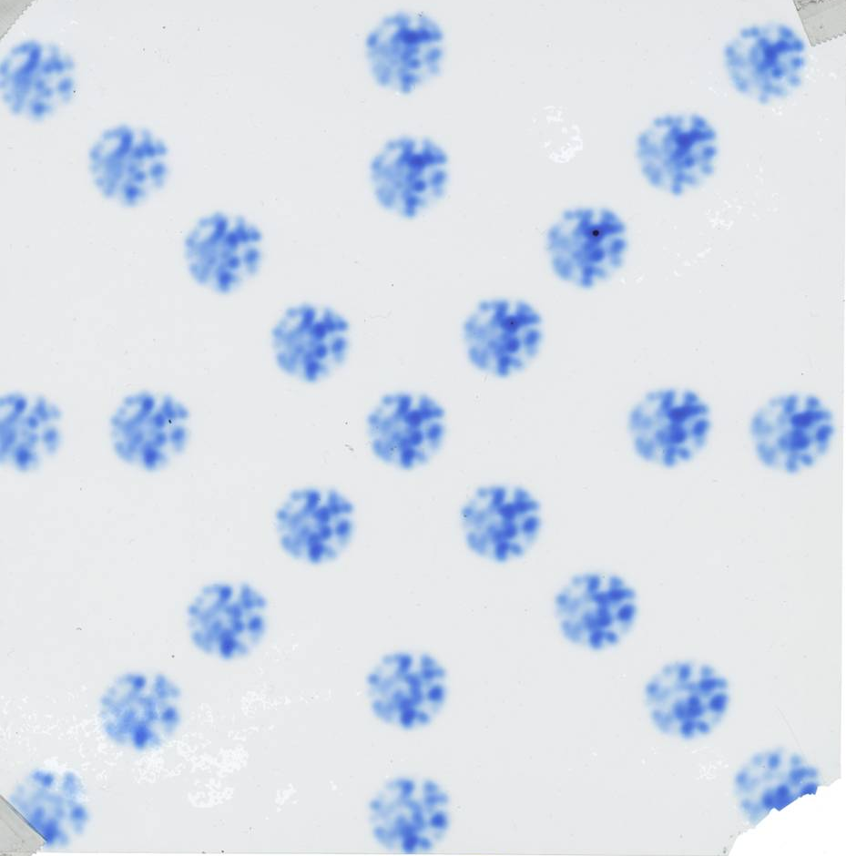
Spotty anode emission
Multiple-pinhole camera diagnoses anode emission and beam microdivergence
Anode diameter
Anode
9932

Slide 37
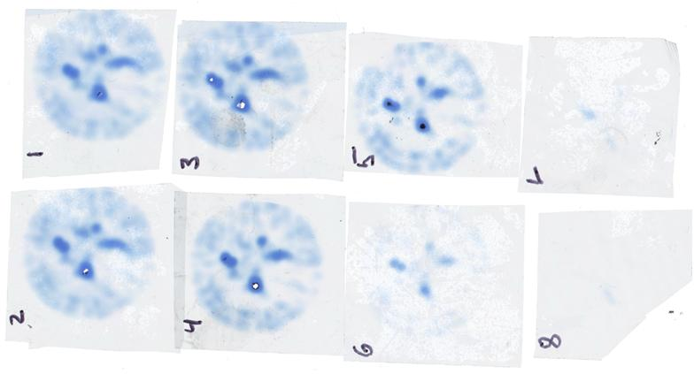
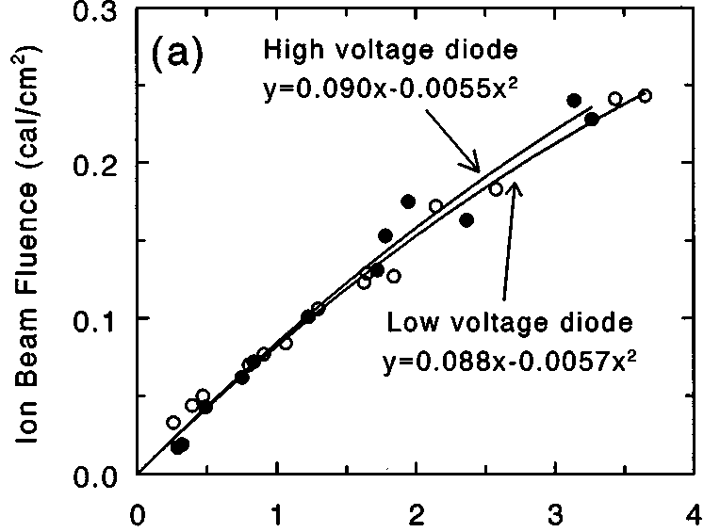
Radiachromic film depth-dose stack diagnoses spectrum
Scanned pinhole-image film stack
Scanner level to OD
OD to fluence (Young, RSI 1998)
Fluence
Scanner level to fluence

Slide 38
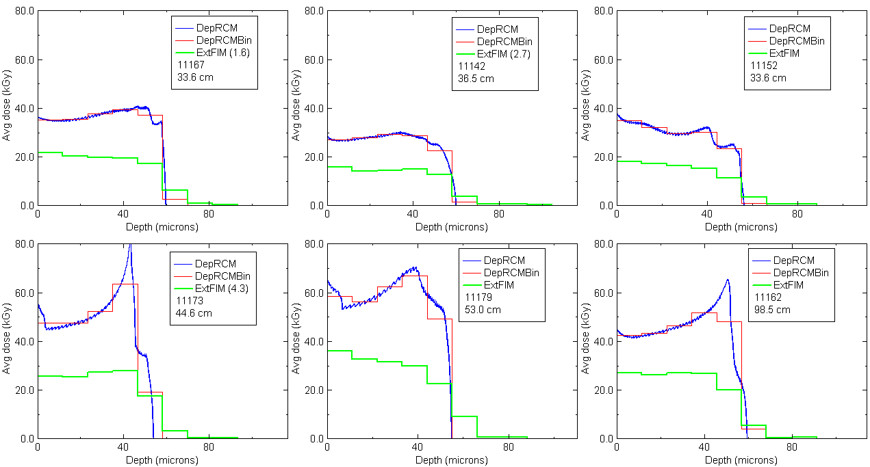
Depth-dose stack measurement consistent with calculation, but suggests slightly flatter profile
Calculation uses analytic formula from SRIM

Slide 39
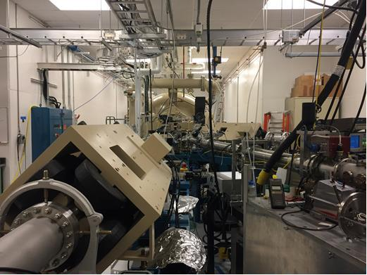
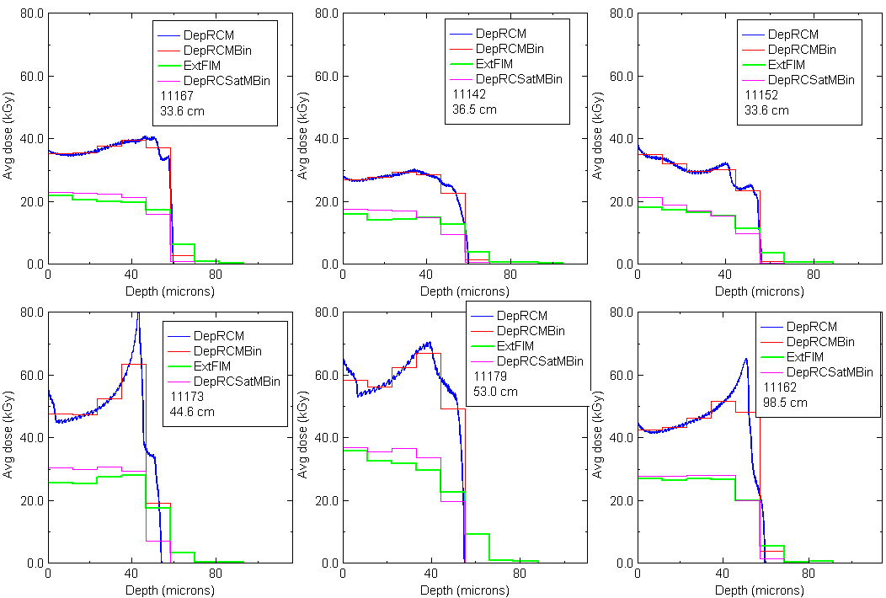
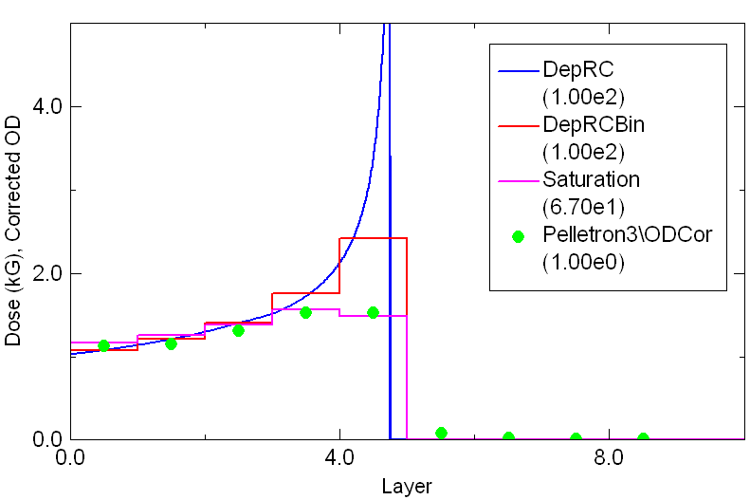
Calibration using SNL Pelletron showed saturation effects
Now exposures match predictions from I,V but cannot be used to determine the spectrum

Slide 40
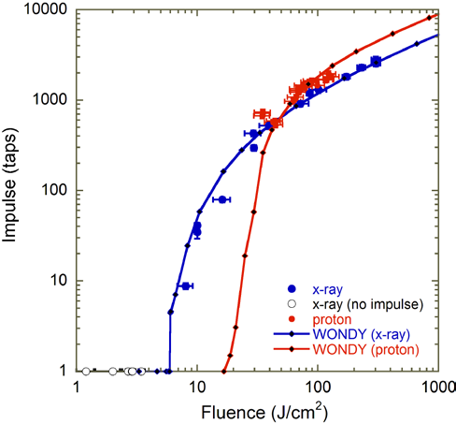
Nathan Moore (SNL) has performed an extensive comparison of x-ray- and ion-induced impulse
Impulse vs. fluence reaching aluminum targets at Z and Gamble II
“Cross-Environment Comparison and Simulation of Blow-Off Impulse in Aluminum,” N.W. Moore, et al., JRERE Dec. 2016
“Proton-Driven Vaporization and Shock in Aluminum, Gold, Polyethylene and PTFE,” N.W. Moore, et al., Sandia Report SAND2016-10741
“Shock histories from x-ray and proton tests were qualitatively similar”
“Such cross-facility comparisons are expected to facilitate evaluation of model uncertainties“

Slide 41
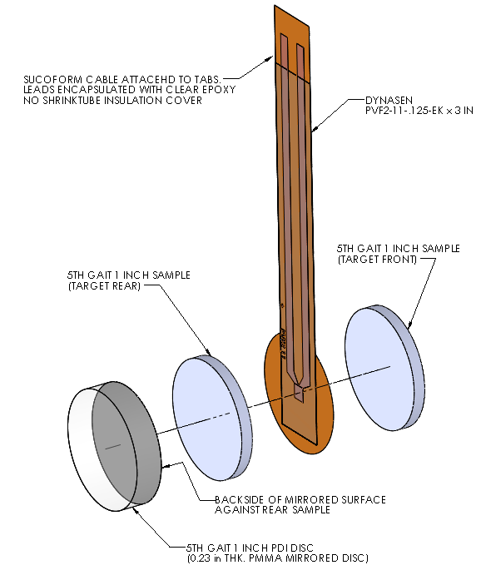
Ion beams have evaluated diagnostics and materials
Combined PDI/PVDF diagnostic on NIF
Dynasen PVDF gauge sandwiched between target material
Tests on Gamble II showed that PDI signal was not adversely affected by the PVDF gauge
Use in optics tests on NIF
Optics samples were tested at low (<1 cal/cm²) fluence to evaluate use of PDI in NIF optics experiments
Sub-micron displacements were measured but results led to PDI not being fielded
Novel materials have been tested
Poor response saved the expense of testing on NIF or Z

Slide 42
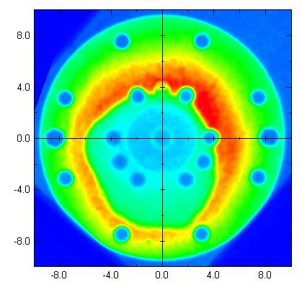
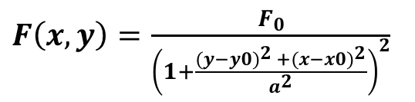
Poor beam uniformity poses the major limitation to this approach
48 cm distance
Activation image
¹²C(p, γ)¹³N reaction activates graphite front plate
Radiographic image plate records distribution
Ablation occurs at ~20 cal/cm²
Uniformity degraded by:
Poor centering
Azimuthal variation
Leptokurtic radial profile
$F\left(x, y\right)=$ $\frac{F_{0}}{{\left(1+\frac{{(y−y0)}^{2 }+{(x−x0)}^{2}}{a^{2}}\right)}^{2}}$
Poor uniformity results in
Large shot-to-shot fluence variation
~20% uncertainty in central fluence

Slide 43
Risk mitigation for XSTENS

Slide 44
To date we have explored small changes
Beam fluence profiles and variations in our recent work are consistent with those in the 1990’s using the backless diode (TN2014-03)
Pre-1991 work with the “standard” diode reported higher fluences and flatter radial profiles (errors?)
Limited by lack of research support until last year
The ion-beam diode is frustratingly resilient
Backless diode seems to work almost the same as standard diode
Transport in vacuum seems to be the same as transport in 1-Torr air
Changes to anode material showed no difference
We have seen significant dependence on Kimfol presence and location

Slide 45
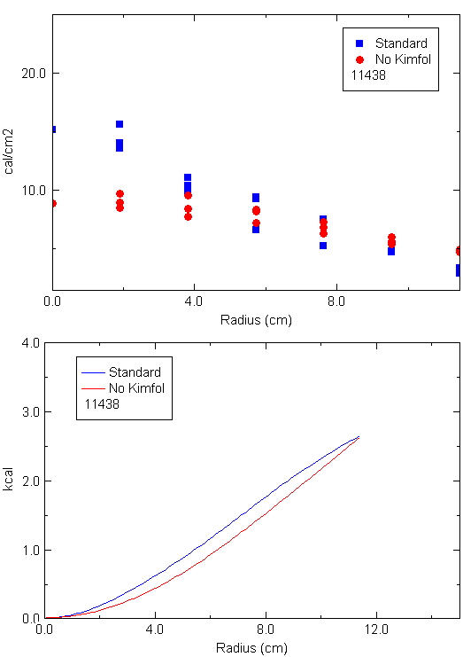
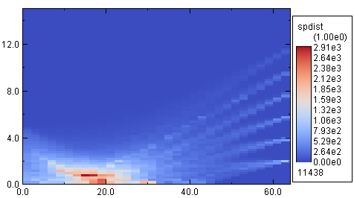
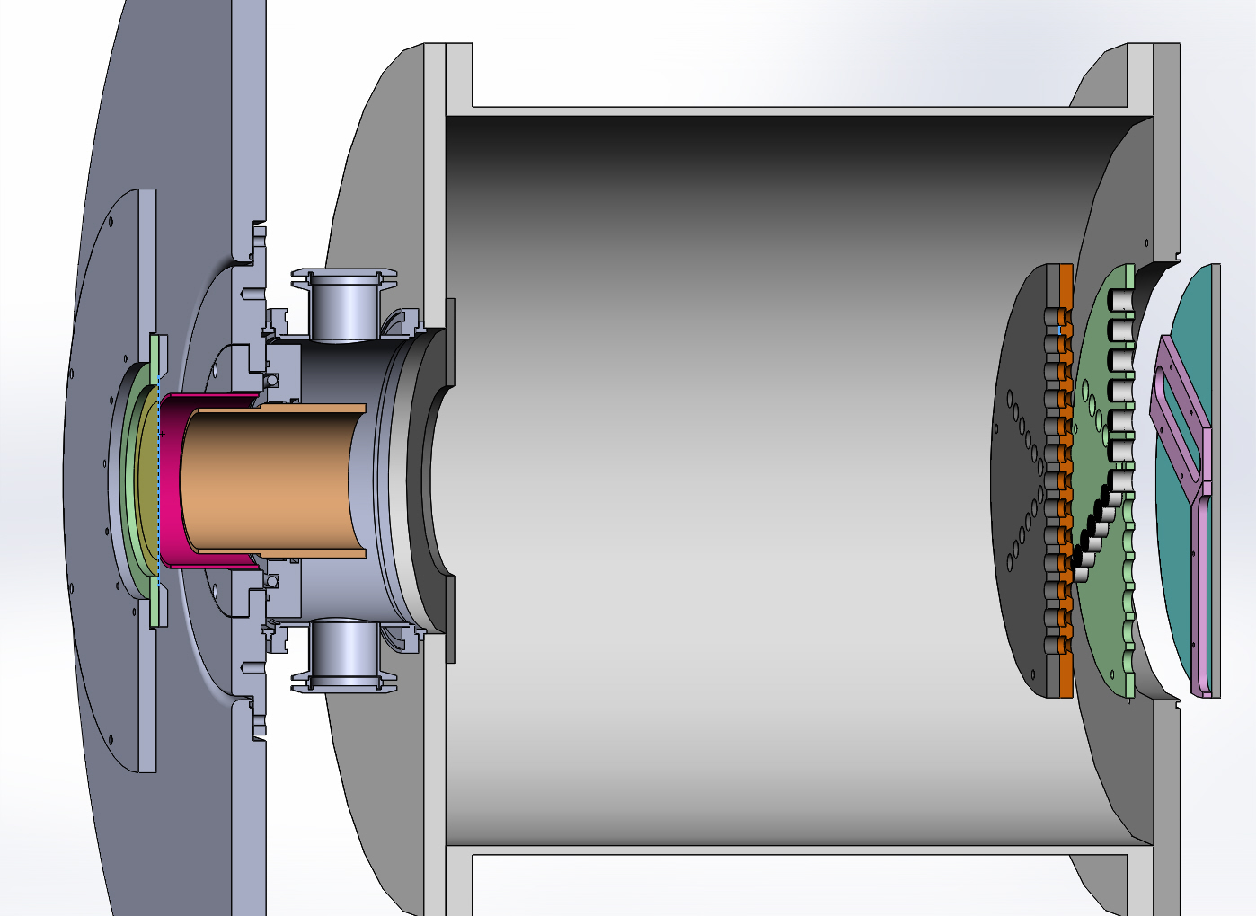
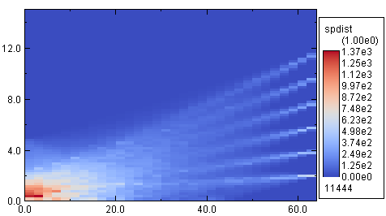
Operation without Kimfol produces wider fluence profile
Fluence
Standard condition
Trajectories mapped
No Kimfol or snout
Energy

Slide 46
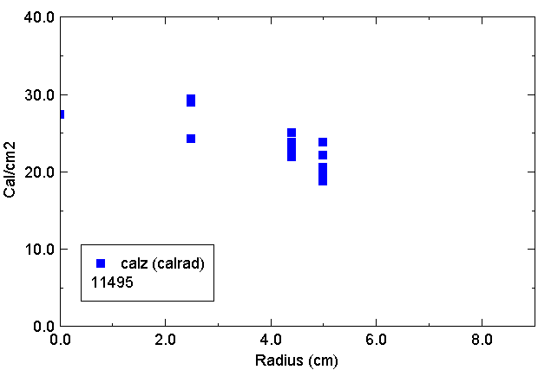
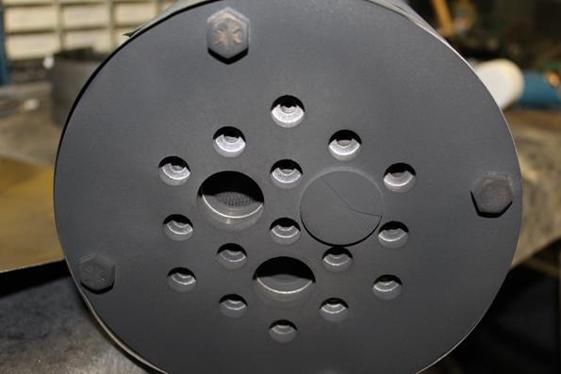
This arrangement was used successfully in a run with AWE in 2017
Fluence at 34 cm
New target assembly allows 3 samples/shot
Basically operating in the near field, so we lose some debris isolation

Slide 47
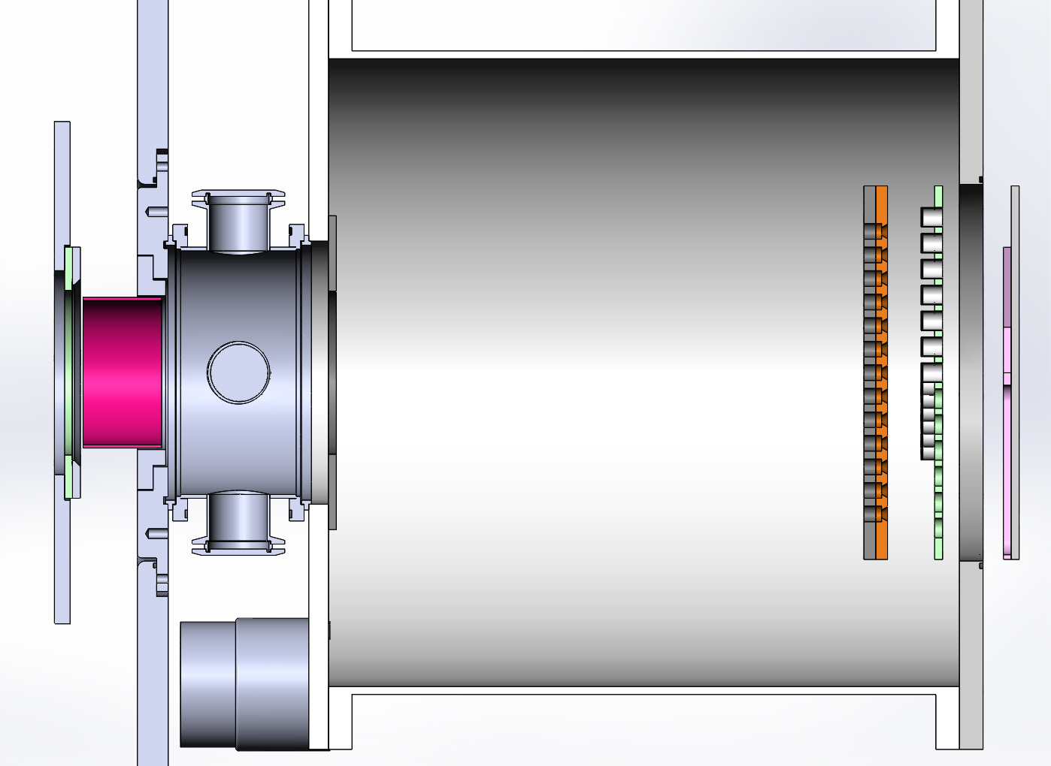
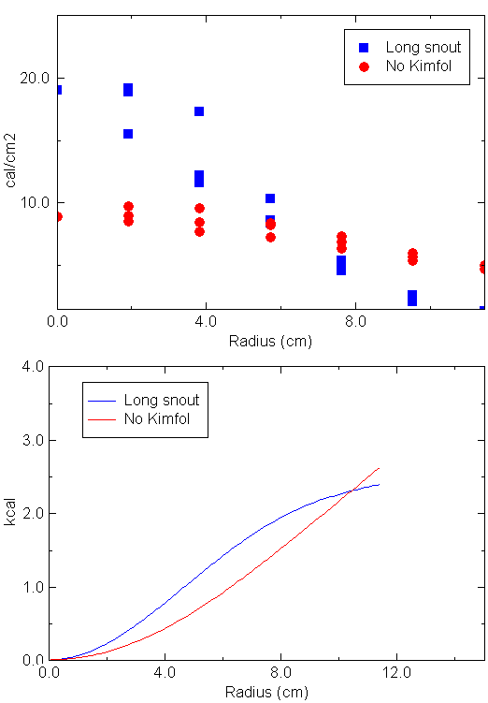
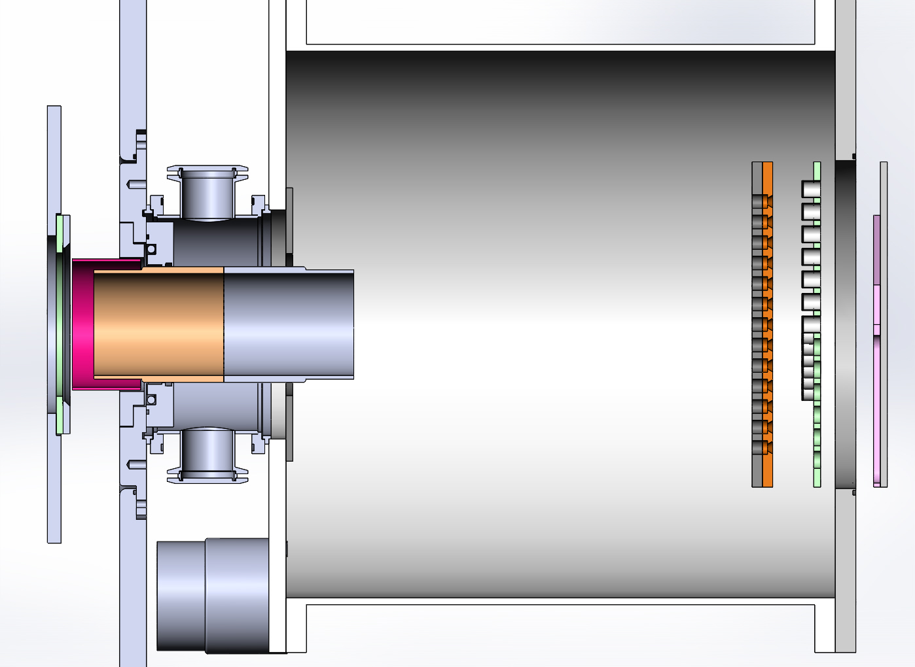
Without Kimfol, snout concentrates beam The physics of this is not understood
No snout
Long snout

Slide 48
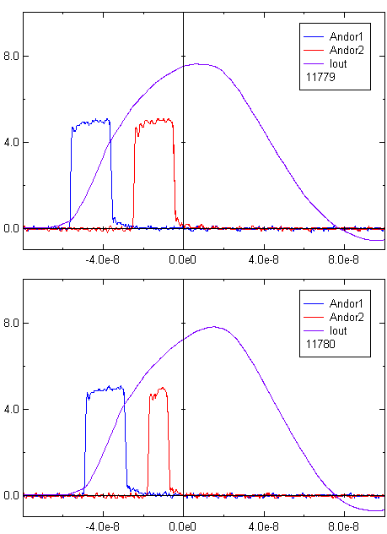
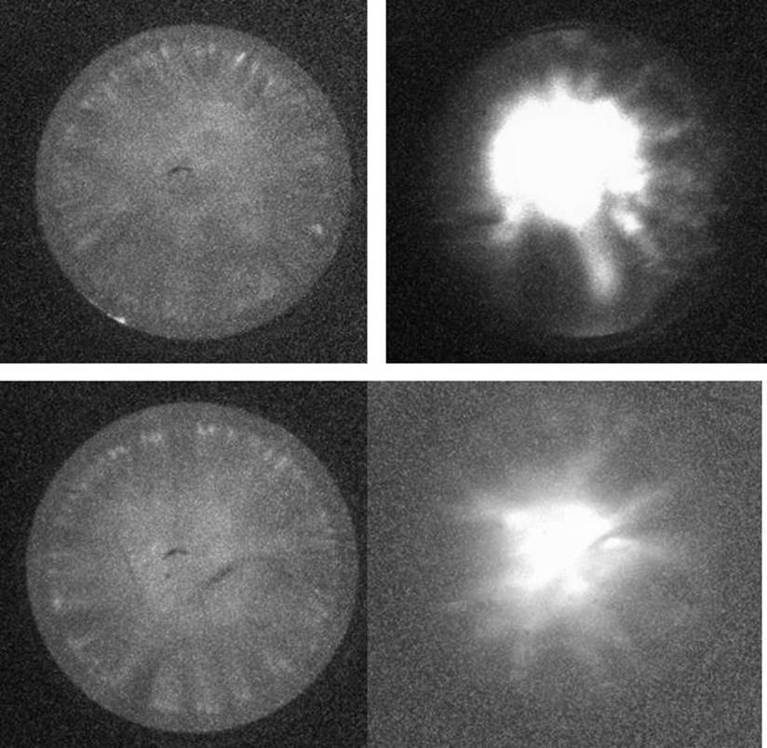
Operation without Kimfol allows imaging of the anode for the first time

Slide 49
Risk-mitigation roadmap: Improving beam quality (uniformity and reproducibility) takes precedence over other (probably necessary) tasks
More extensive diagnostics to characterize beam more fully
Thomson parabola for species identification
Bolometer for time-resolved fluence
Magnetic spectrometer for quantitative spectral information
These were used in the past but not fully developed
Each will take some effort
Numerical modeling of beam generation and transport
LSP modeling to date has not been successful
This will take a significant effort to get right
Why defer these?
All measurements indicate that the beam is well described by the measured voltage and current
I am not optimistic that modeling can reproduce observed nonuniformity

Slide 50
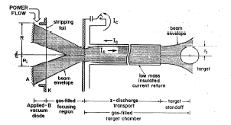
Risk-mitigation roadmap: 3 approaches to improving beam quality
Improve ion-production uniformity
Improve electron flow with larger-area cathodes
Use an active anode source (plasma injection from behind)
Use a smaller diode
Optimize the diode/transport geometry to produce a beam profile more tolerant of non-uniformity
This has been the subject of our work so far, not clear how far we can take this
Use transport
Z-discharge transport studied in 1980’s for ICF applications
Requirements for testing are more relaxed
Paul Ottinger is scoping out nominal setup
Expected to decouple diode from debris
All of the above can be looked at within this year’s scope

Slide 51
With so many other technologies, what is the role of ion-beam testing?

Slide 52
No existing testing technology fulfills all requirements
Mag-flyer
Effectively dead (or maybe not, AWE is interested in upgrading Ampere).
NIF, Z x-rays
Limited target size, limited availability, debris on Z
LIHE
“satisfies NNSA needs”, limited availability and fidelity issues for RVs, no access to front surface
DLI
Possible fidelity issues with penetration depth, unproven for 3-D objects, no access to front surface
Ions
Possible fidelity issues with penetration depth, poor beam quality to date
Temporal fidelity??

Slide 53
Estimates of availability for coupon-sized targets
NIF: 200 coupons/year (modest extrapolation)
2->4 days/year; 3->4 shots/day; 6->12 targets/shot
Z: 30 coupons/year (wild guess)
3 days/year; 1 shot/day; 11 targets/shot
LIHE: 100 coupons/year (even wilder guess)
1 shot/year, 100 targets/shot
NIF DLI: 1000 coupons/year
30 shots/year (spec is 20); 36 targets/shot
OSL DLI: 600 coupons/year
20 days/year; 8 shots/day; 4 targets/shot
Orion DLI: 100 coupons/year (3-Ω)
10 shots/year; 10 targets/shot
Gamble III ions: 1800 coupons/year
180 days/year; 3 shots/day; 4 targets/shot

Slide 54
Ion-beam testing affords risk reduction for mid-size (~10-cm-diam), shaped targets
NIF: doubtful
Z: unknown
LIHE: unknown
NIF DLI: 300 targets/year, but usefulness for 3D targets not established
30 shots/year (spec is 20); 9 targets/shot
OSL DLI: 160 targets/year, but usefulness for 3D targets not established
20 days/year; 8 shots/day; 1 target/shot
Orion DLI: 10 coupons/year, but large-area beam and usefulness for 3D targets not established
10 shots/year; 1 target/shot
Gamble III ions: 600 targets/year with more confidence for success
180 days/year; 3 shots/day; 1 target/shot

Slide 55
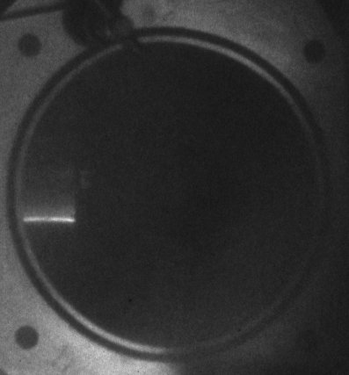
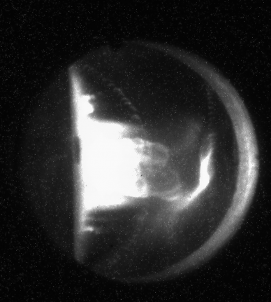
Unlike mag-flyer, LIHE, or DLI, ion beams allow study of blowoff and surface changes
Surface changes – implications for aerodynamics
Blowoff – helps to validate modeling
Experiments with Nathan Moore tentatively planned
40-50 cal/cm²
5 μs after beam, 100-ns exposure
Pre-shot
Target

Slide 56
Intense ion beams continue to have a role in materials-response studies
Model validation by providing an alternate energy-deposition profile
Particularly relevant to sources other than x-rays
A “feeder” for more-expensive testing on NIF or Z
Gamble II has relatively low cost and flexible availability
Testing/evaluation of possible new diagnostics
Inexpensive pre-test of novel materials
DLI may supplant ions for this use
New configuration may allow testing of large coupons (~10-cm diam)
Larger than Janus or Orion (present), comparable to possible future mode of Orion
Begin to investigate 3-D objects
We are considering experiments to diagnose blowoff
, no access to front surface

Slide 57
Intense ion beams are best viewed as a useful complement to DLI
Ions/DLI sit in between LIHE (full area, low fidelity) and X-rays (high fidelity, low area)
Ions complement DLI very well
Deposition profile differs from threat in the opposite direction as DLI -> model validation
Results with 3D objects will be very useful in corroborating DLI 3D results
Applicability to 3D objects is the biggest question mark with DLI at present
Access to front surface allows study of blowoff and post-shot inspection

